Slide 1
Real-World, Worded Problems -for finding the length of a line-
Without Pythagoras theorem we wouldn’t have:
maps,
navigation,
architecture,
engineering or
construction.
Using Pythagoras to calculate the length of lines between coordinates lead to the discovery that the world is round.
Early explorers used Pythagoras’ theorem to navigate using the stars.

Slide 2
Topic : Worded Questions
24
7
30
Date
EQ : How do we answer worded Questions?
C - Circle the numbers in the question
U - Underline the question
B - Box the keywords
E - Eliminate the unnecessary information
S - Solve the question with working out
What is C.U.B.E.S?
When problems involve situations, draw a diagram to help you “see” the problem.

Slide 3
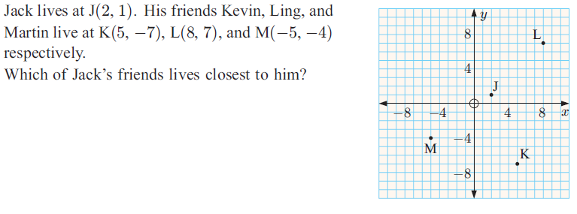


Slide 4
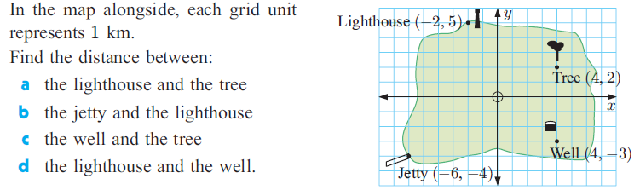

Slide 5
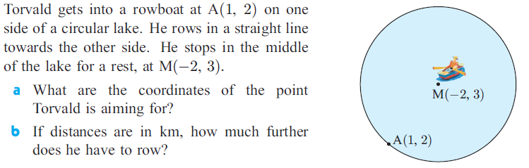

Slide 6
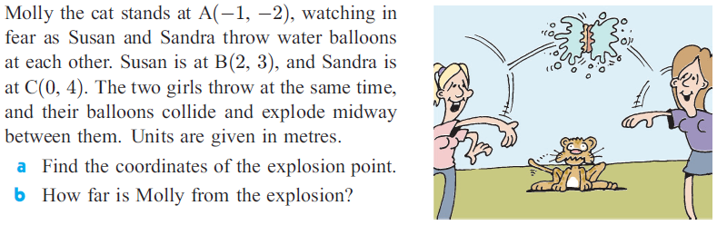

Slide 7
While digging the new Forrestfield train line
using a tunnelling machine,
the operators must travel 900m
starting at 9m above sea level,
and continuing up to 25m above sea level.
What gradient do they need to travel at?

